Slide 1
Environment
and job interview

Slide 2
Let’s discuss https://www.youtube.com/watch?v=_6xlNyWPpB8
How has the world changed since you were a child? (technology, values, environment, health)
How often is garbage collected in your neighborhood?
If humans are really intelligent and not simply manipulated by their genes like any other animal, why can't they do anything about overpopulation?
What are some things that can be recycled?
What are some things which you recycle?
What are some types of pollution?
What can you do to help prevent pollution?
If you could choose one alternative energy source to develop which one would you choose? Why?
Are companies more or less environmentally responsible now than they were in the past? Why do you think that is?
What are some ways energy is wasted?
What types of energy are popular in your native country?
What can large cities do to improve their air quality?
How can we protect the environment and at the same time improve people's standard of living?

Slide 3
Vocabulary
be banned (from)
(garbage) dump
habitat
exhaust fumes
species (of)
acid rain
be aware (of)
carbon dioxide
chop down
(cut) emission
contaminate
(be) extinct
die out
creature
detergent
endangered
disposal
sewage

Slide 4
Grammar

Slide 5
Will it trouble you a lot if Peter dog stays with us for a week?
It won’t trouble me if his dog stays in our flat but be sure that I won’t look after it.
WILL IT TROUBLE YOU (A LOT) IF I ________?
HIM SHE ________S?
YES, IT WILL TROUBLE ME (A LOT), BECAUSE __________.
NO, IT WON’T TROUBLE ME (AT ALL) IF _________.

Slide 6
Let’s talk – interview practice
Can you tell me a little about yourself?
How did you hear about the position?
What do you know about the company?
Why do you want this job?
Why should we hire you?
What are your greatest professional strengths?
What do you consider to be your weaknesses?
What is your greatest professional achievement?
Tell me about a challenge or conflict you've faced at work, and how you dealt with it.
Why are you leaving your current job?
What type of work environment do you prefer?
Why was there a gap in your employment?
Can you explain why you changed career paths?
How do you deal with pressure or stressful situations?
What are your salary requirements?
Do you have any questions for us?

Slide 7
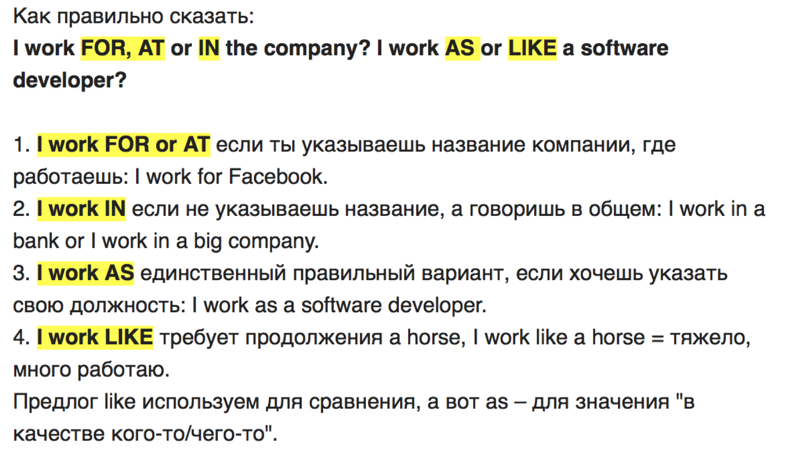

Slide 8
Homework
Essay: what are you eager to do to protect our environment?
Make 2 sentences with each word
Make 6 sentences with new grammar pattern

